Slide 1
Splunk for Data Science
By: Santosh Cheruku

Slide 2

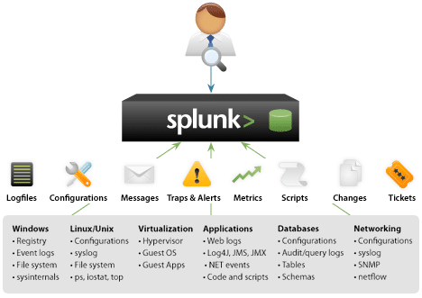
Collect data from multiple sources
1. App log files
2. Query logs
3. Network logs
4. Config logs
5. Many more

Slide 3
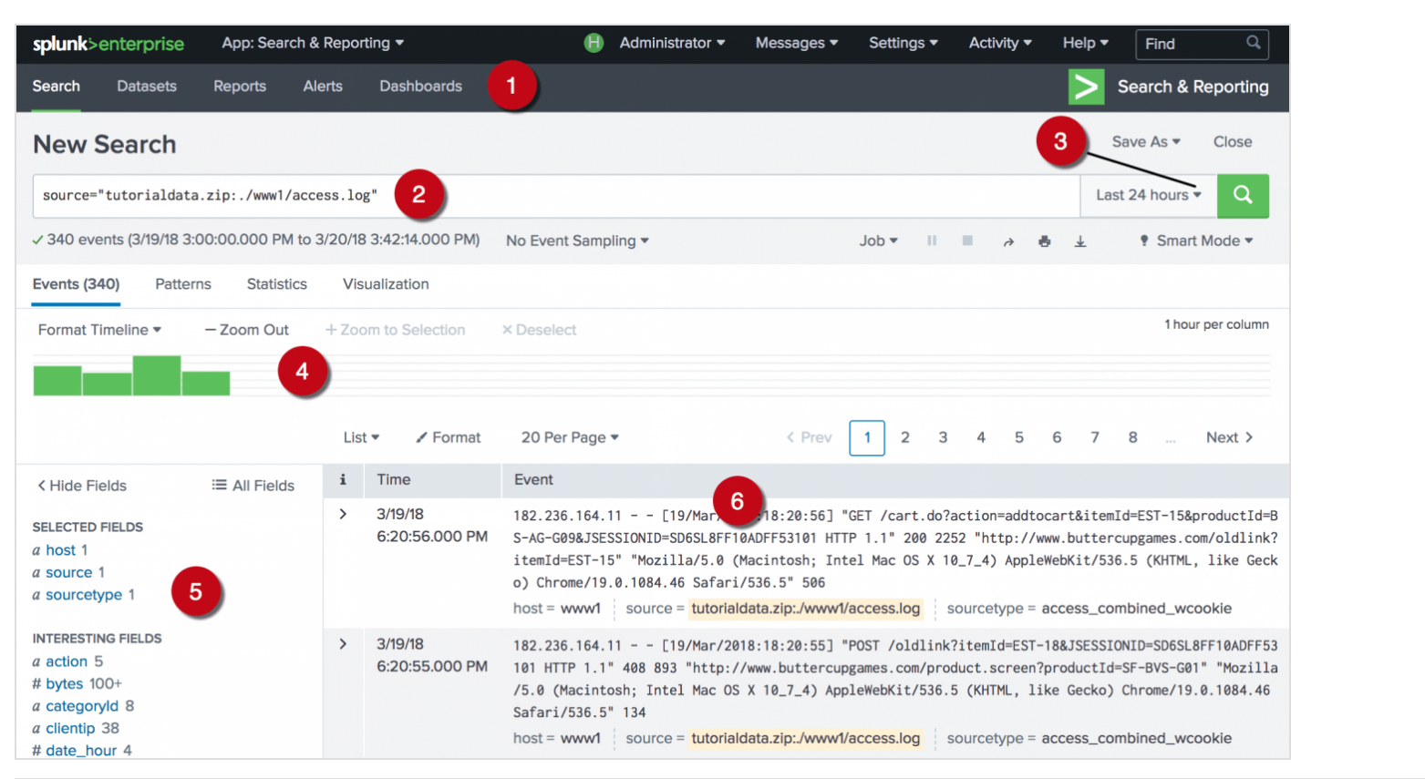
Data search
1. Apps bar
2. Search bar
3. Time range
4. Timeline
5. Field picker
6. Data

Slide 4

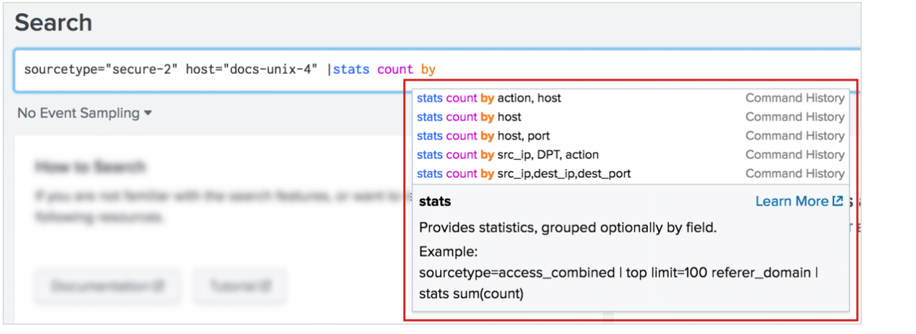
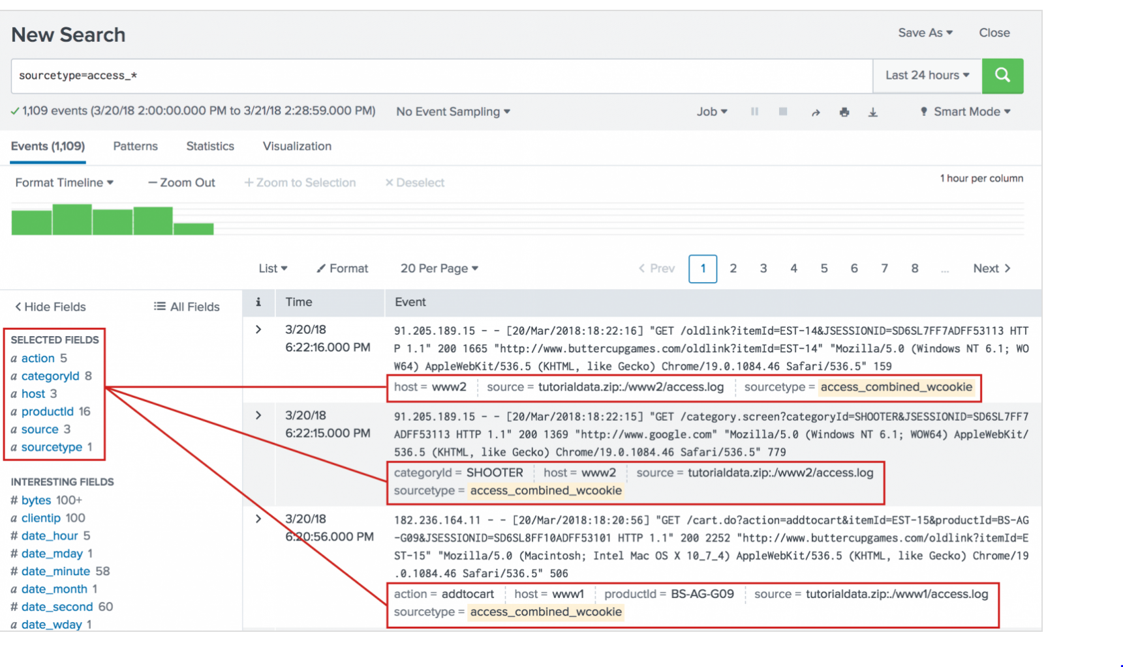
Splunk: Search Processing Language(SPL)
Allow searching the data sources by running commands written according to SPL specific to Splunk.
Allows creating custom variables with in queries
Supports concatenating multiple commands using piping option
Allows to combine regular search queries and aggregation commands such as top, stats, max, min etc
Supports generating timecharts, pie charts, bar charts etc

Slide 5
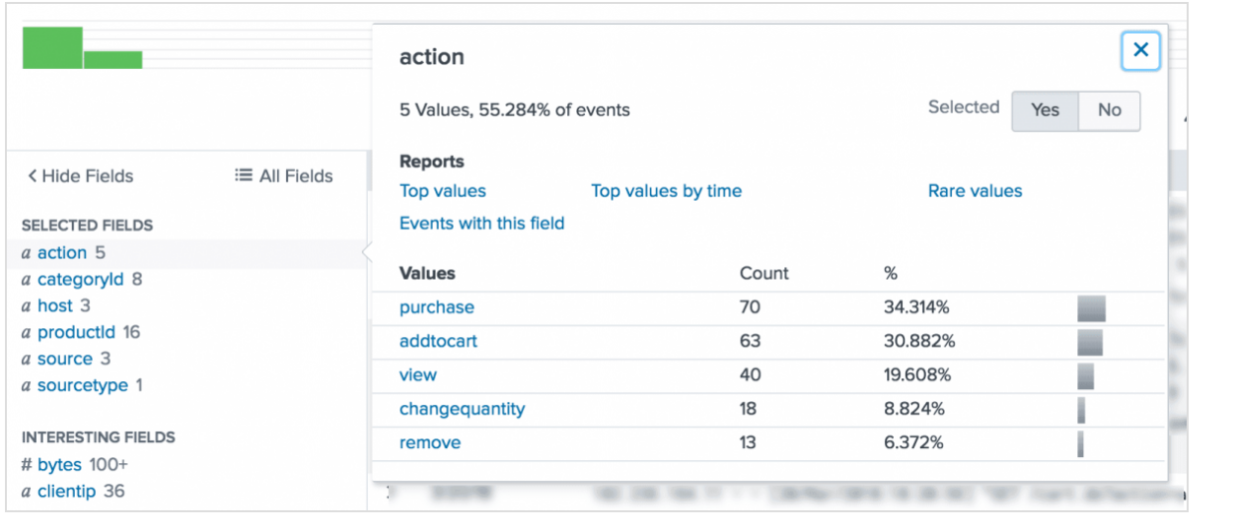
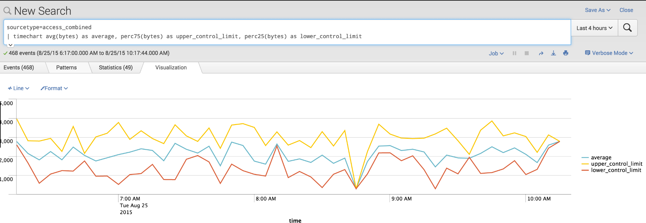
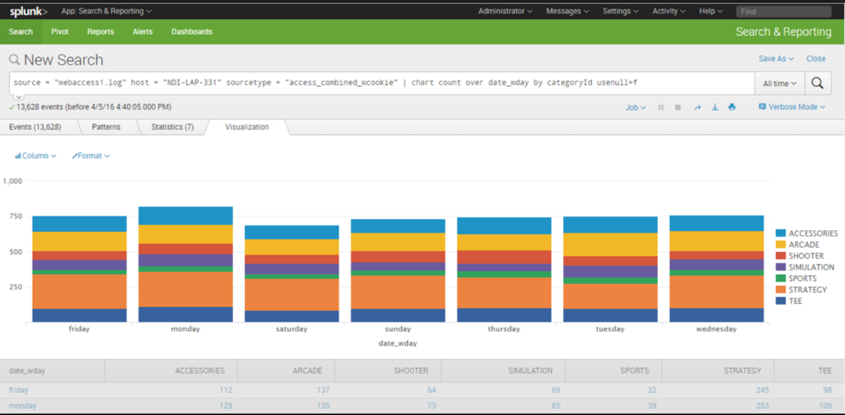
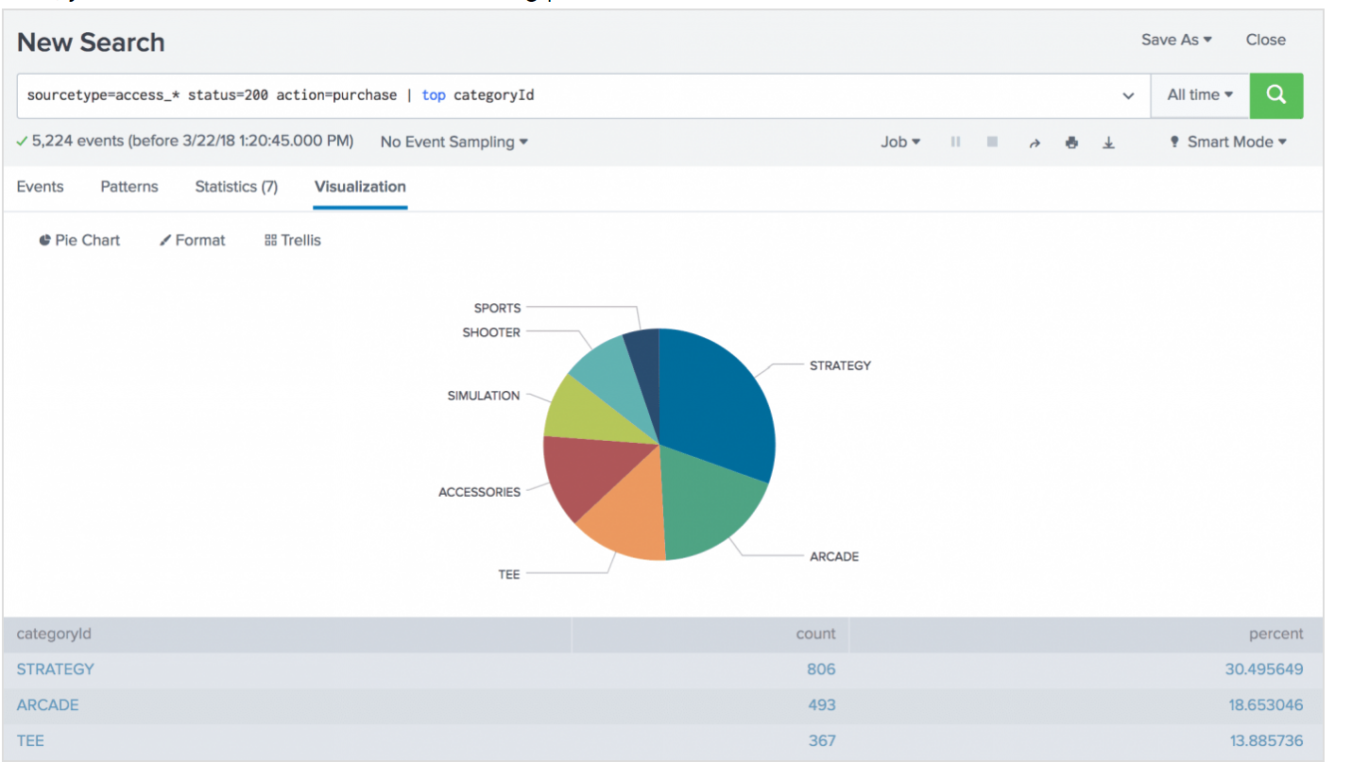
Visualization of results

Slide 6
Splunk SDK
Splunk provides SDK (Software Development Kit) which allows to integrate the tool with other programming language
As of now Splunk SDK supports Python, Java, JavaScript, C#.
Channel splunk generated events into different programs and run custom logic
Splunk also exposes REST API calls which allow API driven interaction with the tool

Slide 7
Splunk for Data Science
It’s much useful for running analytics on near real time data
Useful for generating quick stats by running SPL queries against huge datasets from multiple data sources
Pretty good at identifying trends and issues at real time
Configure alerts or notifications on real time situations
Chart and visualize statistics
Machine learning and anomaly detection

Slide 8
Thank you!

